Slide 1
Git and LabVIEW Hands-On
Implementing source control using Git with your LabVIEW applications

Slide 2
Source Control
Notes:
What exactly is “source control”?

Slide 3


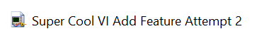
Source Control
Why should be care about source control?
Scenario:
1. You have a finished VI that is polished and works.
Main.vi
2. Decide to add a new feature, so you make a copy and develop further with it. You’re really done now though.
Main Final.vi
3. Okay, for real this time. You’re really done.
Main Final v2.vi
This approach rapidly becomes space-intensive and disorganized.
Notes:
Source control is NOT a new concept. This should be highly relatable even to those who have never used a source control program.
#TODO
Simplify animations

Slide 4
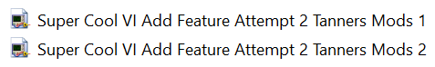
Source Control
It gets even worse when you have multiple people working on one project.
Scenario: Tanner helps you with the new feature.
Benji decides to help as well.
Git is a revision control system we can use to make source control easier.
Notes:
#TODO What is the main point of this slide? What’s worse about this than before?

Slide 5



Git, GitHub.com, GitHub Desktop
Git
Git is a version control system for tracking changes in computer files and coordinating work on those files among multiple people.
GitHub.com (GitHub Inc.)
Web-based hosting service for version control using Git.
GitHub Desktop Desktop client application created by GitHub Inc.

Slide 6

Getting Started
Exercise
Prepare your computer for the exercises.
Make an account on GitHub.com.
2. Download and install GitHub Desktop from https://desktop.github.com/.
Notes:
#TODO Remove exercise instructions from slide or generalize words to not point to specific tools. Provide instructions on where to find the guide.

Slide 7
Introduction to Repositories

Slide 8


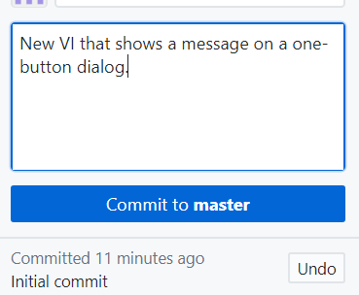
Repo Creation and Initial Commit
Exercise
With GitHub Desktop:
Create a repo.
Perform the “initial commit”: Add initial version of files to the repo.
Detailed instructions found in sections 1.1 and 1.2.
Notes:
This is section 1.2 in the Markdown document.

Slide 9
Committing Changes

Slide 10


Committing Changes
Commit (also used as a noun): A revision/set of changes to the project files.
Group together related changes in a single commit to make your commit history easy to understand.
Notes:
Heh.

Slide 11
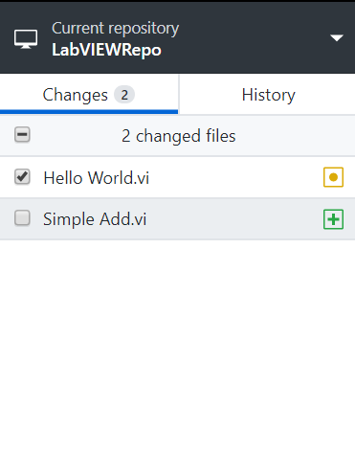
Commit Changes
Exercise
Make a change to the VI in your repo.
Create a new VI to add to the repo.
See that the change and the new VI are automatically detected in GitHub Desktop.
Commit these in two separate commits (using checkboxes).
Detailed instructions found in section 1.3 Committing Changes.

Slide 12
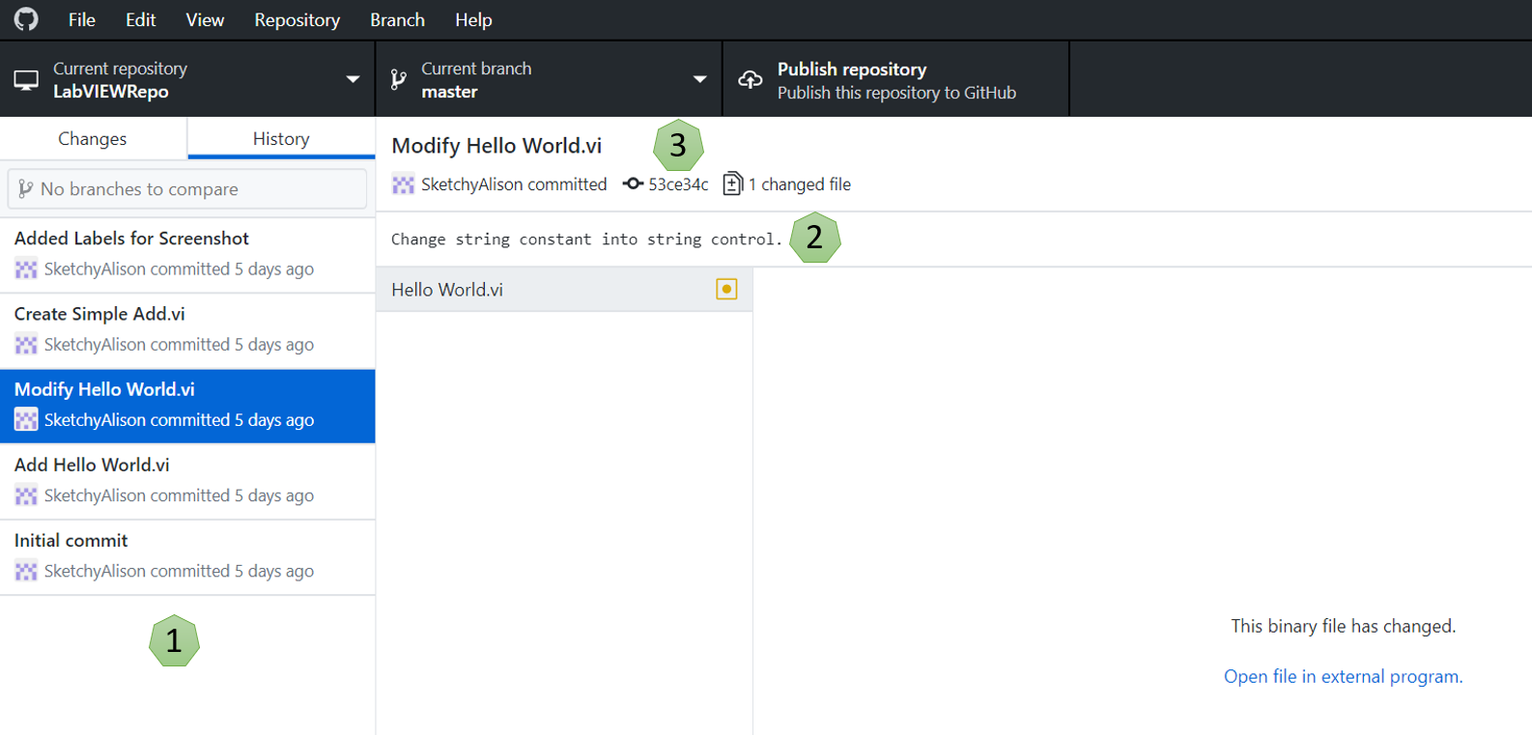
Explore History Tab
Exercise
Commit summary.
Commit description.
A unique ID is created for every commit. This is sometimes called the SHA or the hash.
Detailed instructions found in section 1.4 History.

Slide 13
Remote Repositories

Slide 14


Our Current State
Our repo resides on our local machine.
We can:
What if:
Our computer bricks and the files are lost?
Track changes via commits.
A colleague wants to access and change the files?
View our commit history.
Revert changes if needed.
Solution: Publish to a remote repo.
Notes:
The repo we have on our local machine is currently the only copy. Make them recognize that this does not address backups and multiple users.
#TODO Simplify animations

Slide 15

Publish to Remote Repo
Publish: Create a Copy
GitHub.com Servers

Slide 16
Publish to Remote Repo
Fetching, pulling, and pushing refer to transferring changes between the local and remote copies of the repo.
Fetching, Pulling
Pushing
Local
GitHub.com Servers
Fetching and pulling are similar but slightly different. Pulling automatically merges retrieved changes into the local copy, while fetching only retrieves changes (does not automatically merge).
Notes:
Question for audience: If pushing changes serves to back up your work, how frequently should you push? Benji’s recommendation is about every 30 minutes, at most you ever risk losing 30 minutes of work.

Slide 17
Remote Repo
Are GitHub.com servers the only option?
No.
Other options for remote repo:
Another web-based hosting service
A server running at your site
Notes:
#TODO Remove animations

Slide 18
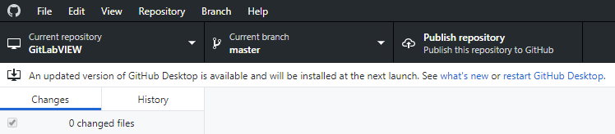
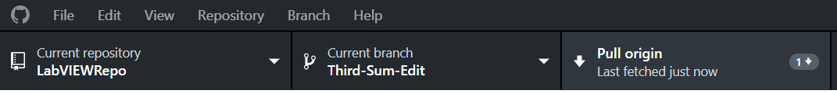
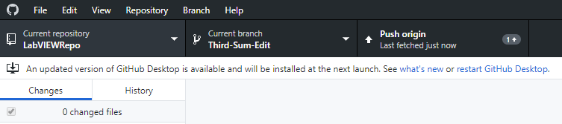
Working With a Remote Repo
Exercise
Publish your repo to GitHub.com.
Make a change from GitHub.com, pull changes into your local repo copy.
Make a change in your local repo copy, push changes to GitHub.com repo.
Detailed instructions found in sections 1.5, 1.6, and 1.7.

Slide 19
Branches

Slide 20

Challenges With Multiple Users
Pulling is OK with multiple users.
Pushing can cause conflict:
Whose version takes precedent?
Remote Repo
Branches can help address conflict issues.
Notes:
#TODO Simplify animations

Slide 21
Branches
Branch creates parallel copy of master (primary) branch
Changes to the branch do not affect the master and vice versa
A branch is usually made specifically for:
New feature
Bug fix
Changes (commits) made in branch are merged back into the master when work is complete
Branch is then deleted
Branch
Feature
Master
Notes:
The lecture on branches should only be a quick overview, it all makes a lot more sense after the exercises in 1.8 and 1.9.

Slide 22
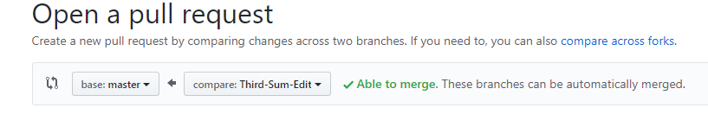
Branches
Pull Request
Branches should not be merged back into master without testing and review
Pull Request: Request to merge
User with elevated permissions to the repo must approve the pull request
Each pull request has a discussion forum in GitHub.com
New commits can be made while a pull request is submitted, the request will update
Feature
Master

Slide 23

Branches and Pull Requests
Exercise
Create a branch.
Make changes in the branch.
Merge back into master.
Feature
Master
Detailed instructions found in sections 1.8 Branches and 1.9 Merging Branches and Pull Requests.

Slide 24
LabVIEW and Git:
Special Considerations with LabVIEW Applications

Slide 25
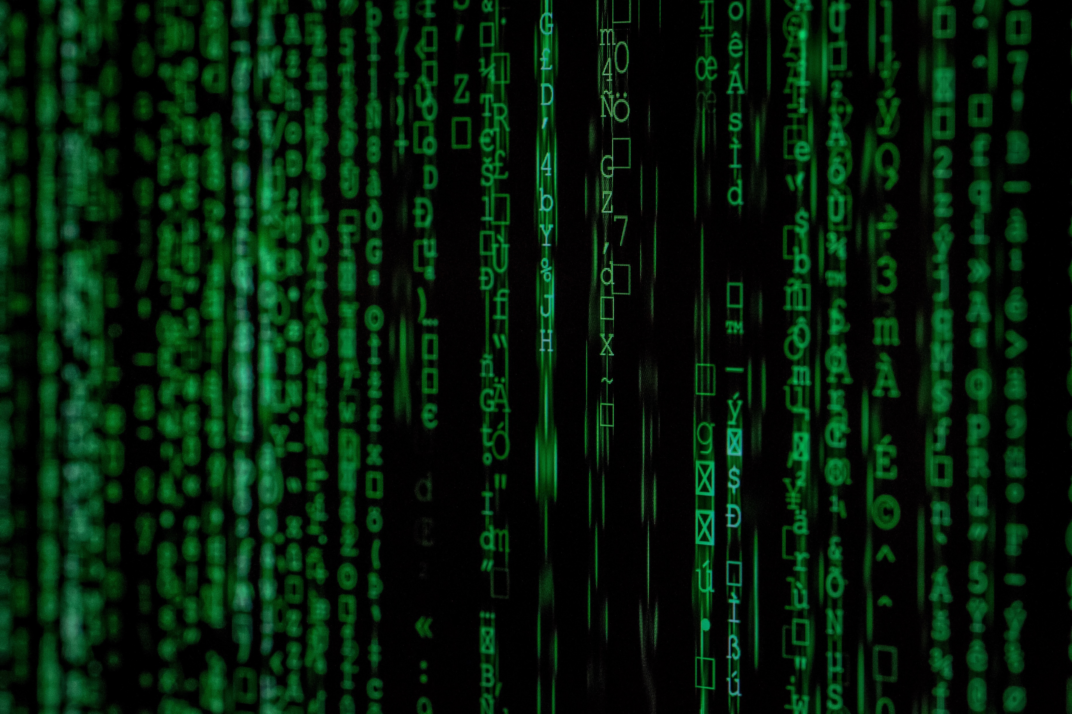
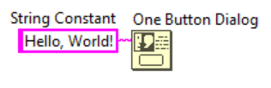
By default, a VI stores two types of code together:
1
2
Graphical source code that you edit in the LabVIEW development environment
Compiled code that LabVIEW uses to run the VI
Think about a commit description you might write.
Are you describing changes to 1 or 2?

Slide 26
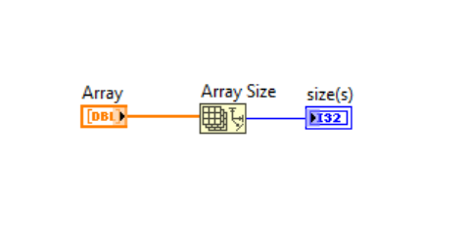
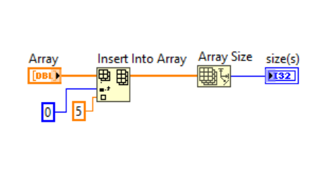
Examples of commit descriptions:
“Add labels to loops.”
“Consolidate TDMS write into subVI”.
We care about tracking changes to the graphical source code.

Slide 27
The compiled code can change even when the graphical source code hasn’t:
Compiled binary code may not be exactly identical between two compiles
Compile for different target or OS
Git detects changes in both the graphical source code and compiled code if they are stored together in a VI.
Result: Excess changes detected.
We only want to commit changes to the graphical source code.

Slide 28
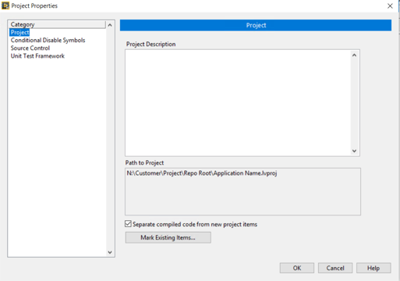
Solution:
Setting to store compiled code in compiled object cache instead of with the VI.
Project Properties >> Project >> Separate compiled code from new project items.
Use Mark Existing Items to select which existing items you would like to have separated compiled code.
Notes:
Pause for a moment to have them view this setting from a LabVIEW project.

Slide 29
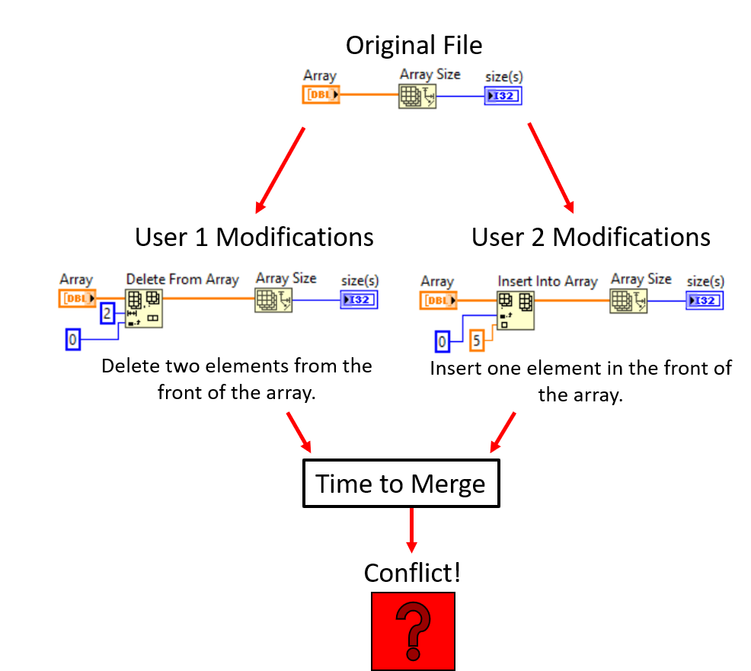
“Merge Battles”
Scenario:
Two branches are created off master.
Each branch edits the same file (VI).
Both branches try to merge back into master.
How do we prevent this?

Slide 30
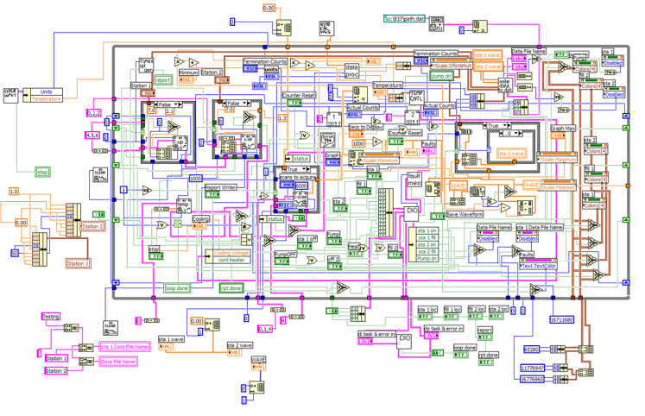
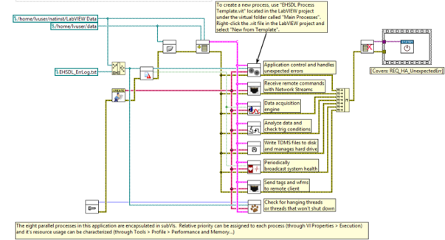
Avoiding Merge Battles: Code Organization
Bad:
Good:
Organize code into subVIs (different files).
Notes:
SubVIs in the code shown are grouped by function:
Application control, handles unexpected errors
Receive remote commands with network streams
Data acquisition engine
Analyze data and check trig conditions
Write TDMS files to disk, manage hard drive
Periodically broadcast system health
Send tags and wfms to remote client
Check for hanging threads

Slide 31
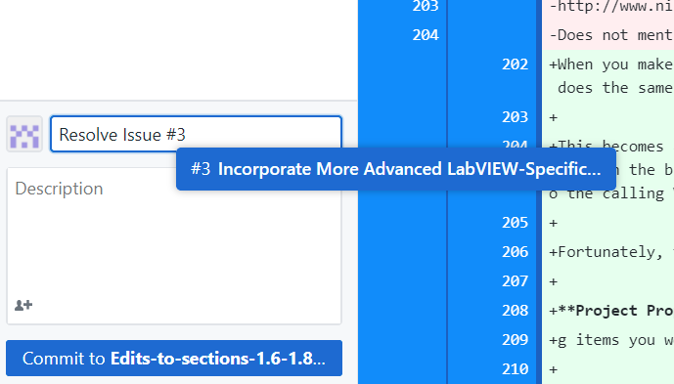
Avoiding Merge Battles: GitHub Issues
Communicate with your team members to understand who is assigned which modifications.
Scope branches to a single feature or bug.
Use GitHub Issues to track and assign changes.

Slide 32
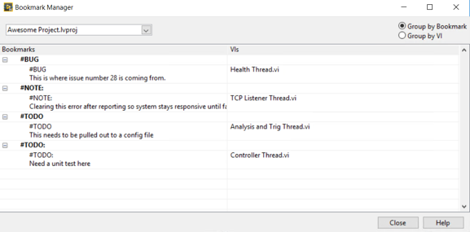
Avoiding Merge Battles: GitHub Issues
Use LabVIEW bookmarks as a tool to document bugs, quirks, future changes.
Bookmarks are automatically created when you add # to a label.

Slide 33
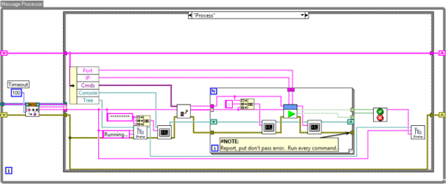
Explore Tools
Exercise
Create a GitHub Issue.
Explore using LabVIEW bookmarks.
Detailed instructions found in section 2.0 Using LabVIEW and Git.

